Slide 1

Virtual Health Management with Robotics
Problem Statement:-

Slide 2
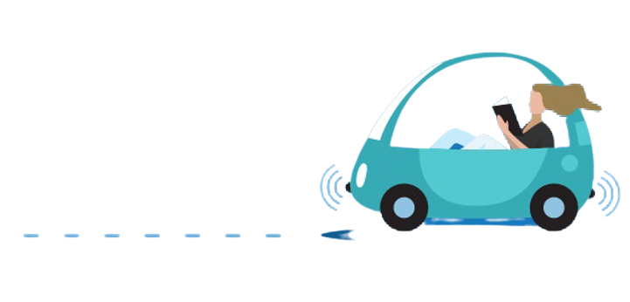
Virtual Health Management USING Robotics
OBSTACLE AVOIDING + REMOTE CONTROL + VOICE CONTROL + GESTURE CONTROL
+
FIRE DETECTION SYSTEM
+
EFFICIENT DELIVERY SYSTEM

Slide 3
INTRODUCTION
Today viruses attacks us in different ways, to deliver the medicine to the affected person in the isolated room it is difficult to deliver the medicine due to the communication of such viruses will be in easy way. so to avoid this situation we develop a smart vehicle to deliver the medicines.

Slide 4
1.Obstacle Avoidance:
1
In this case, We developed the robot with a very good intelligence which is easily capable to sense the obstacle and by processing the signal coming from the sensor it is perfectly avoiding the obstacle coming in the path.
So, Ultrasonic Sensor is mainly used for this purpose.

Slide 5
2.Remote Control:
Robot car is controlled by using Android mobile phone ,the same robot car can also be used to control via gesture,obstacle and rf etc.
An application has to be downloaded from playstore to control the car in forward, backward, left and right directions.
For this Bluetooth module is used.
2

Slide 6
3.Voice Control:
3
The aim of Voice Controlled Robotic Vehicle is to perform the required task by listening to the commands of the user.
This also requires a Bluetooth module and mobile app.

Slide 7
4.Gesture Control:
A Gesture Controlled robot is a robot
which can be controlled by your hand gestures.
You just need to have a Gyroscope in our mobile,
which included an acceleration meter to transmit
an appropriate command to the robot.
so it can do whatever we want.
4

Slide 8
5.Drivers Anti SleEP Alarm:
Eye blink Sensor is a relatively simple sensor used to detect eye blinks.
It uses a simple infrared sensor to detect if the person's eye is closed and the corresponding data received can further be processed by any logic as required for the application.
The eye blinks system comes with an IR sensor mounted on glasses which the user can wear like regular glasses.
5

Slide 9
6.FIRE DETECTION SYSTEM:
With the advancement of technology, developments in the face of situations that can result in the loss of human life are becoming more prevalent.
It dectect the fire by using fire sensor then it give the intimation to the driver then alarm will range.
6

Slide 10
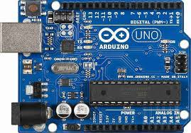
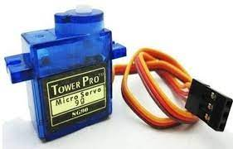
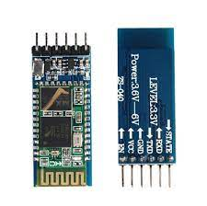
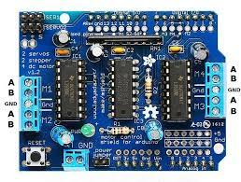
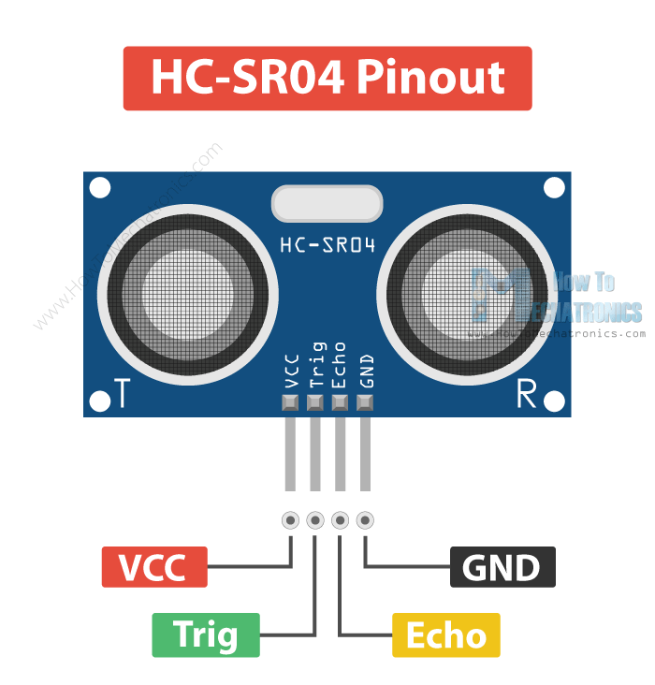
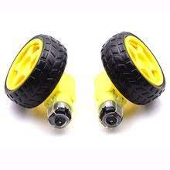
COMPONENTS IMAGES:-
.

Slide 11
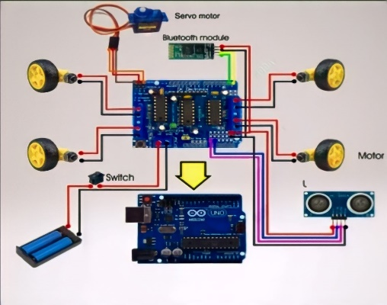
CIRCUIT DIAGRAM

Slide 12
APPLICATIONS : OBSTACLE AVOIDENCE:
It can be used in army applications.
It can be used in mining vehicle.
It is used in industrial purposes.
REMOTE CONTROL:
It can be used Surveillance System.
It can be used in army to carrying bullets etc.
This wireless devices has no foundation of range
& can be controlled as far as network of cell phone.

Slide 13
VOICE CONTROL:
It can be used for Handicaped Persons.
It can be used in Mining Vehicle.
It is used in Industrial Purposes.
GESTURE CONTROL:
It can be used in industries to control trolly and lift.
It can be used in construction field.
It can be used in medical applications.

Slide 14

DRIVERS ANTI SLEEP ALARM:
This system alerts the user if he/she falls asleep at the wheel thereby, avoiding accidents and saving lives.
This system is useful especially for people who travel long distances and people who are driving late at night.

Slide 15
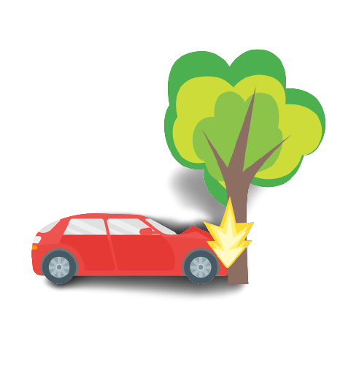
WHAT ABOUT THE SAFETY…?

Slide 16
IT WAS DESIGNED AS A HYBRID PROTOTYPE :
As it is a hybrid model it can perform multi functions by
Using a single controller(ARDUINO) at a same time.
By this the safety measurements can be further Increased such that ,
Colliding vehicle that is being controlled by various inputs with
Obstacle Avoiding. Can prevent the collisions and decreases the
accident cases.
THAT HYBRID COMBINATIONS ARE:
OBSTACLE + REMOTE CONTROL.
OBSTACLE + GESTURE CONTROL.
OBSTACLE + REMOTE CONTROL + GESTURE CONTROL.
OBSTACLE + VOICE CONTROL.

Slide 17
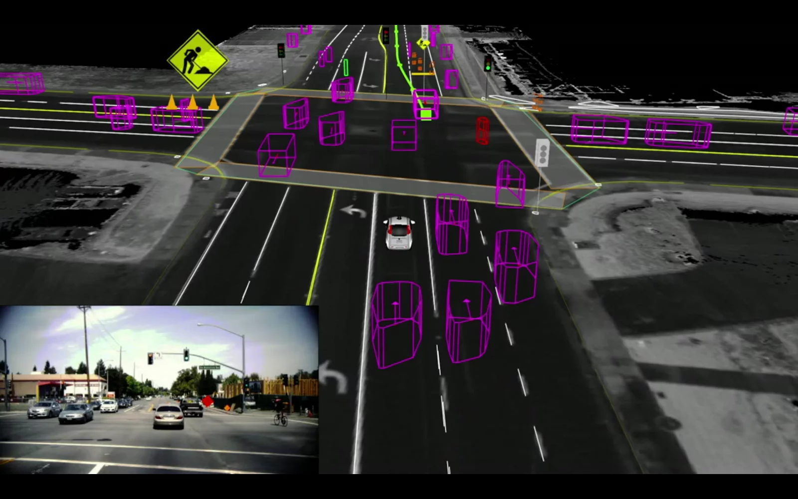
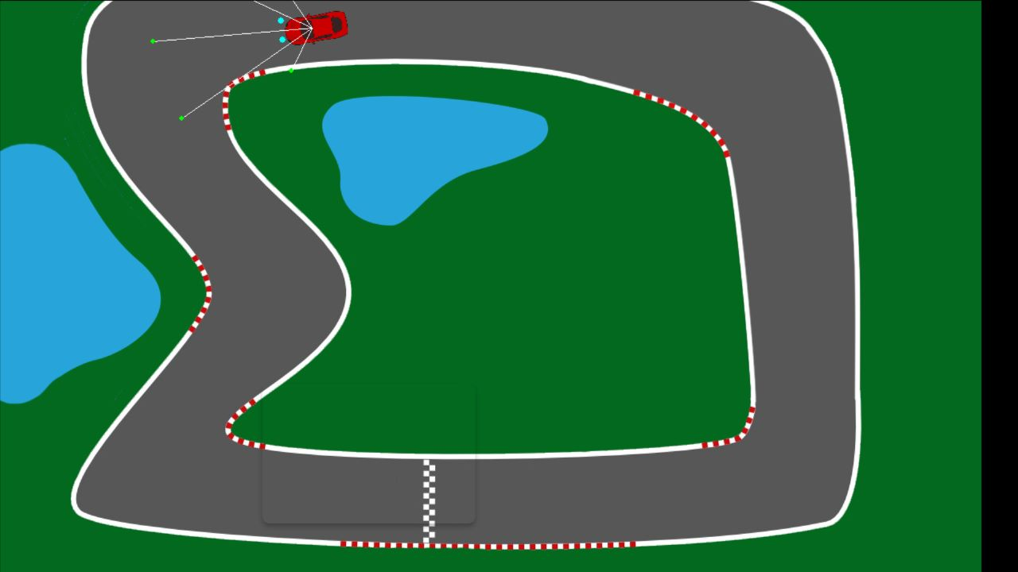
Future Extension:
The development of self-driving cars
is one of the most trendy and popular
directions in the world.
So, We want to implement all this
features by using Machine Learning.
We created a Self Driving Stimulation by using Neural Netwoks:
Here we see the self driving application,
tells the how car moves itself.
For Future extension we can run this
code in Raspberry Pi Microcontroller for
Hybrid outputs.

Slide 18


